Slide 1
Caching Annotations
@Cacheable : Triggers cache population
@CachePut : Updates the cache, without interfering with the method execution
@CacheEvict : Triggers cache eviction[removing items from cache]
@Caching : Regroups multiple cache operations to be applied on a method
@CacheConfig : Shares some common cache-related settings at class-level
@EnableCaching : Configuration level annotation, enables Caching

Slide 2
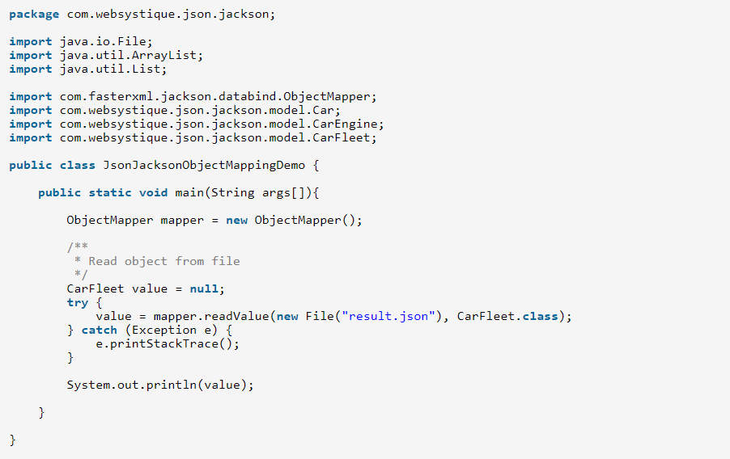
Converting JSON to/from Java Objects using JACKSON API
ObjectMapper is the main api used for data-binding. It comes with several reader/writer methods to preform the conversion from/to Java and JSON
Read JSON from a file and convert into Java Object

Slide 3
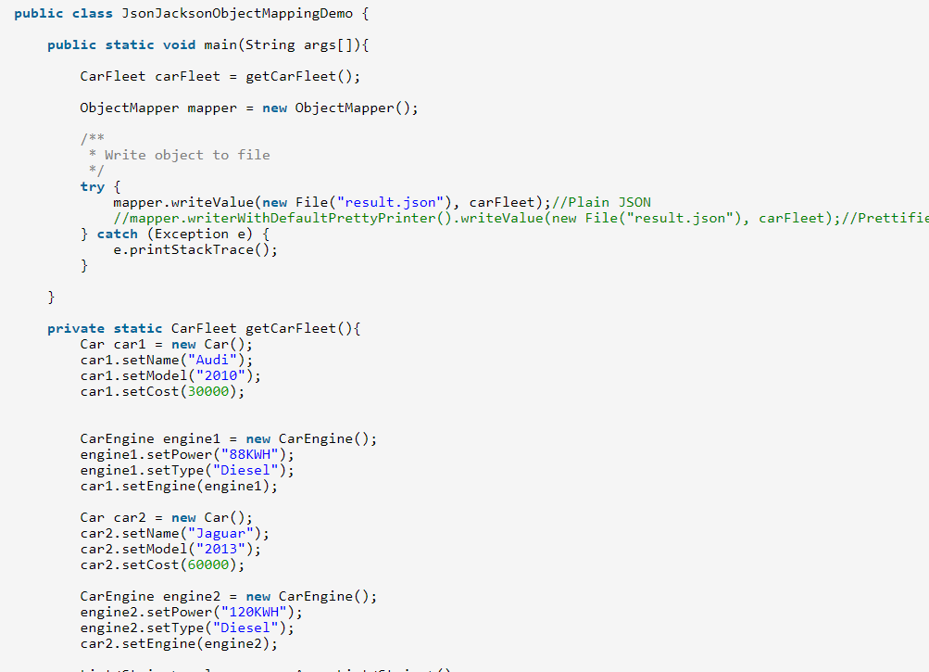
Convert Java Object to JSON and write JSON to a file

Slide 4
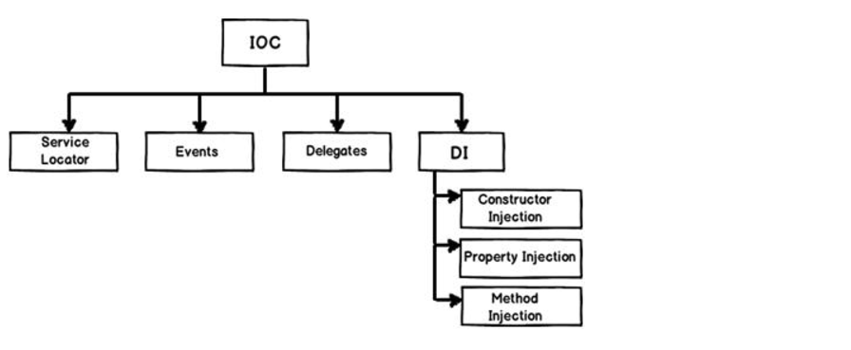
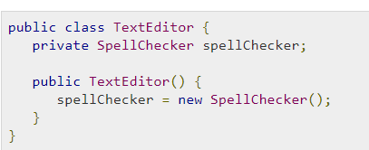
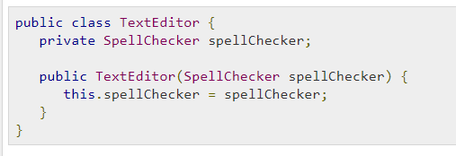

Slide 5
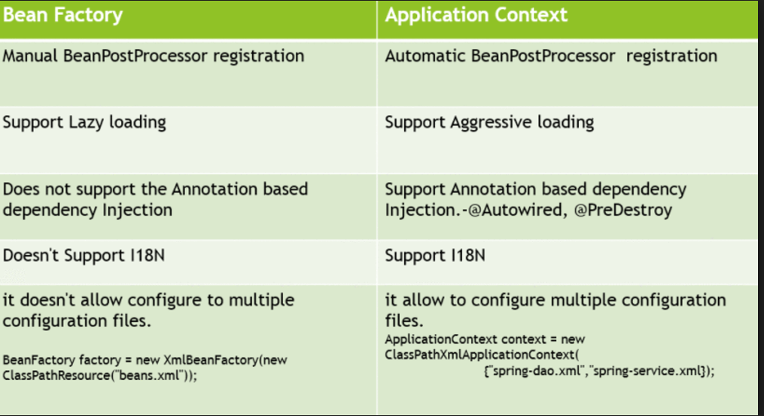

Slide 6
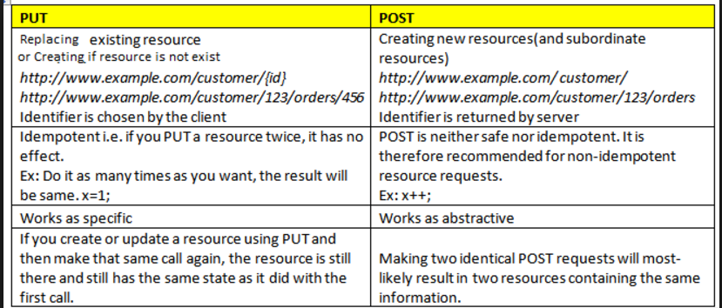

Slide 7
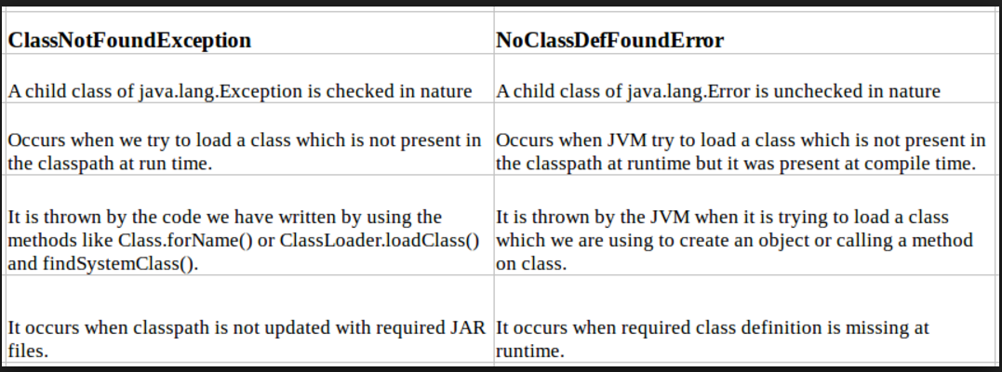

Slide 8
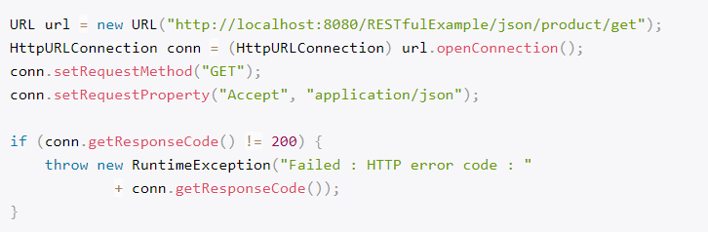
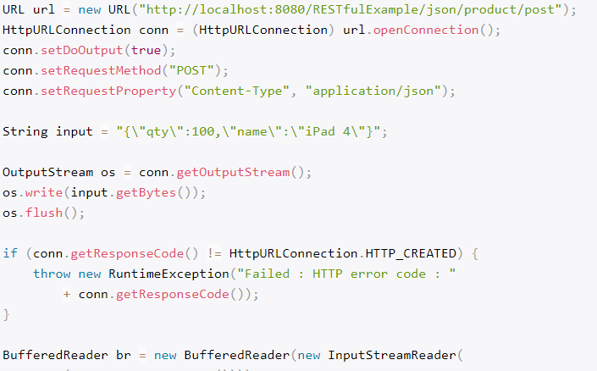
Java client to send a “GET” request.
Java client to send a “POST” request,
with json string.

Slide 9
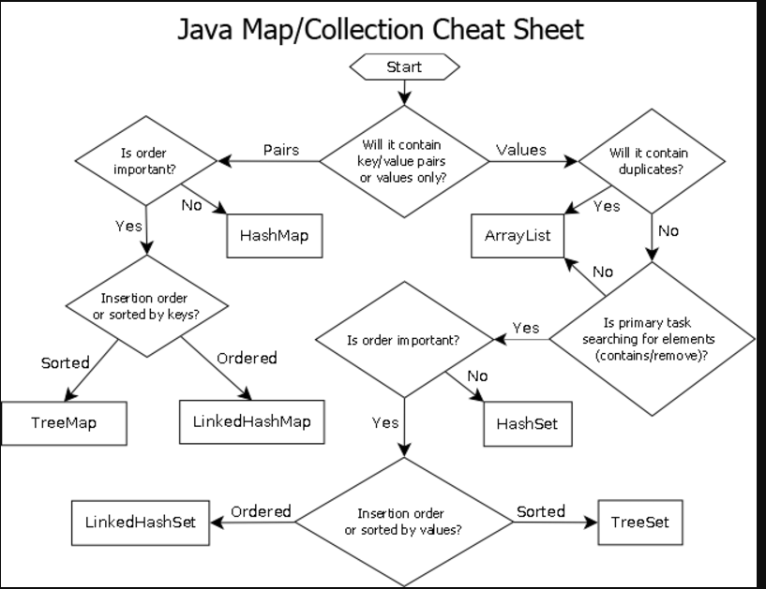

Slide 10
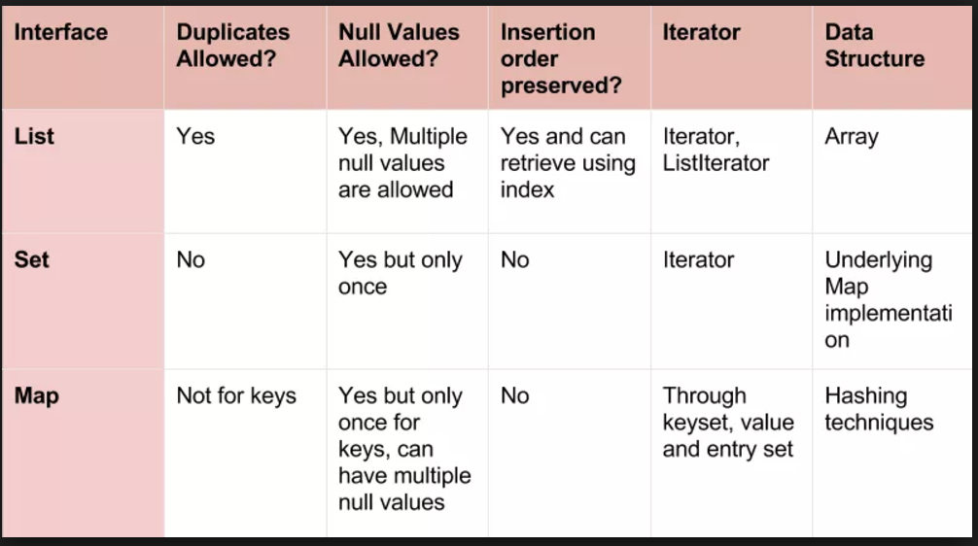

Slide 11
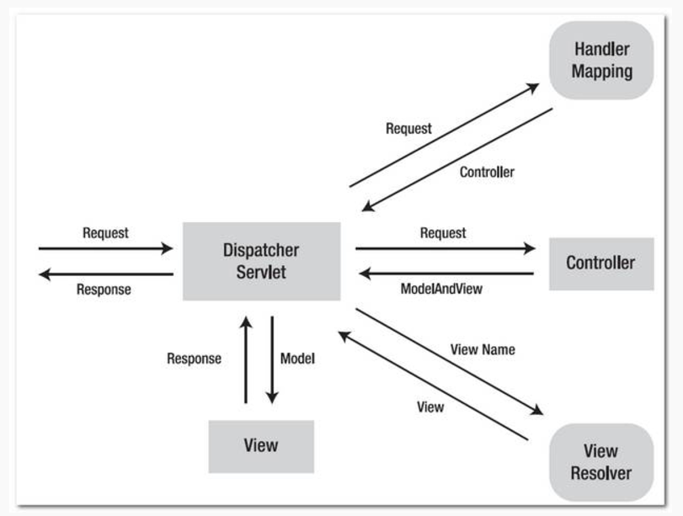

Slide 12
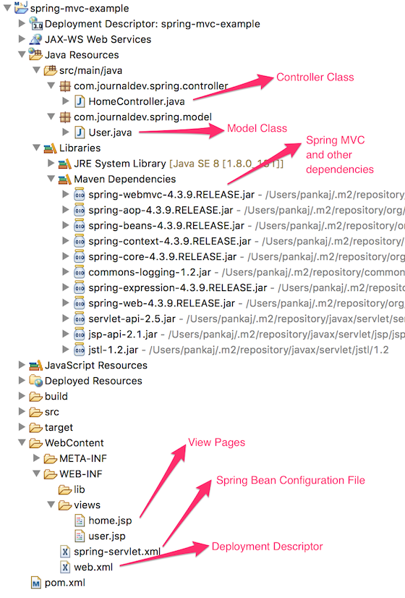

Slide 13
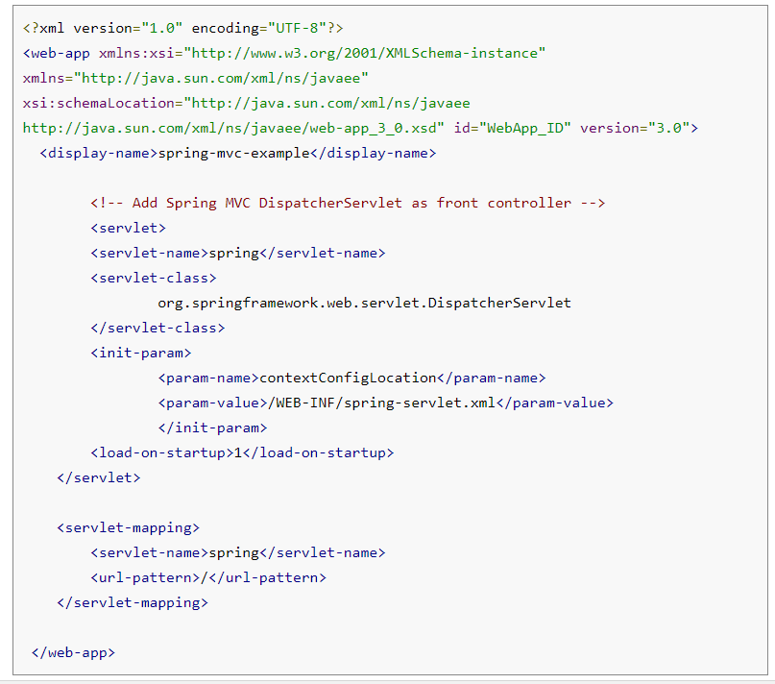

Slide 14
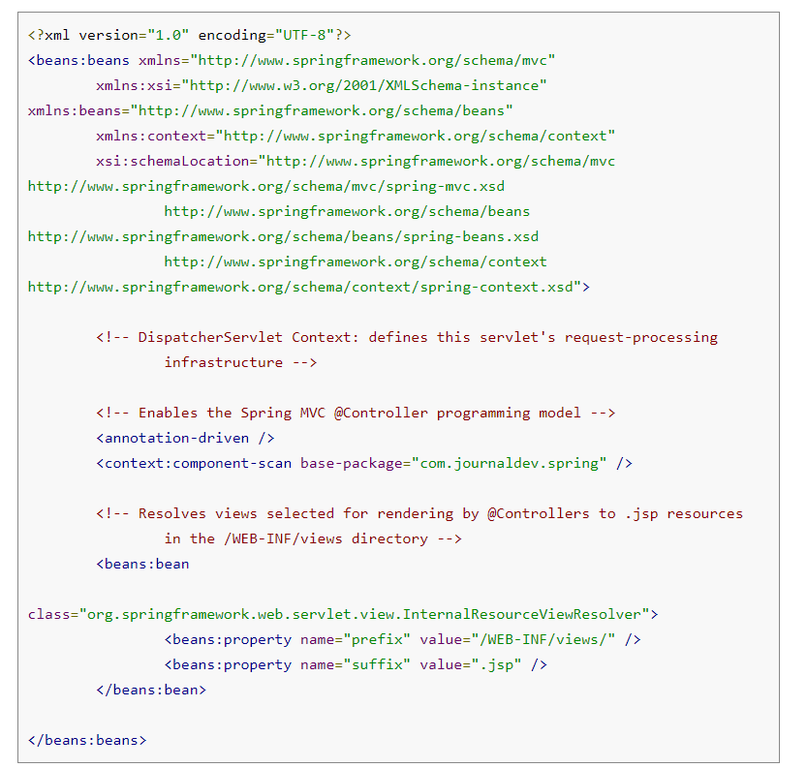

Slide 15
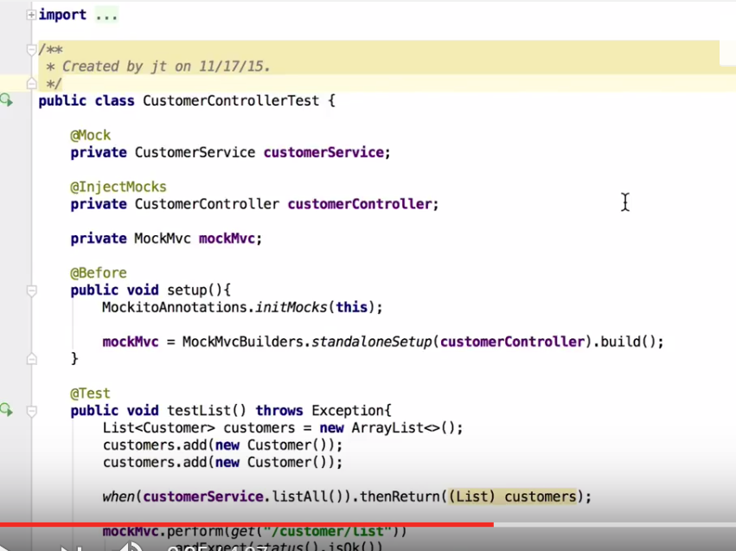

Slide 16
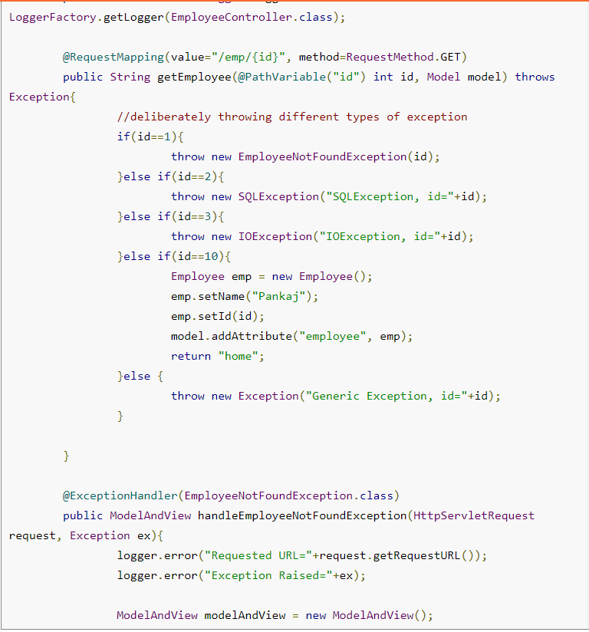
Spring MVC Exception Handling –
@ControllerAdvice,
@ExceptionHandler,
HandlerExceptionResolver

Slide 17
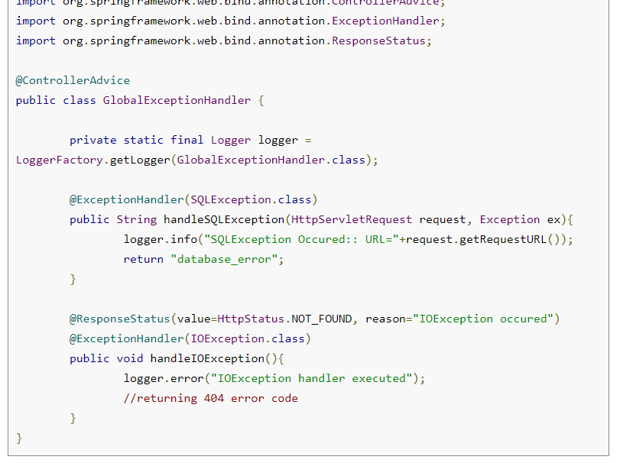

Slide 18
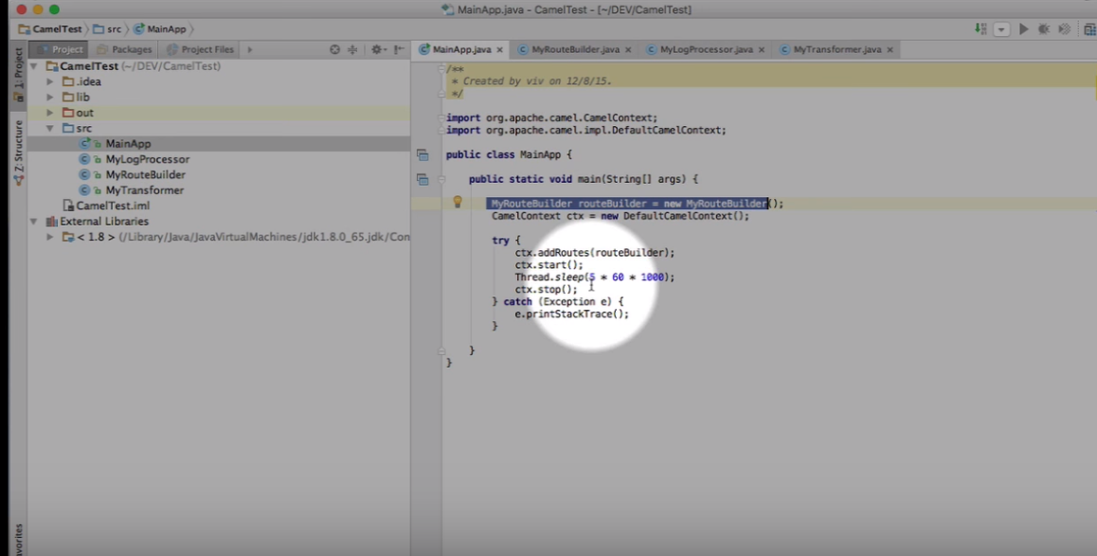
Apache Camel first Steps

Slide 19
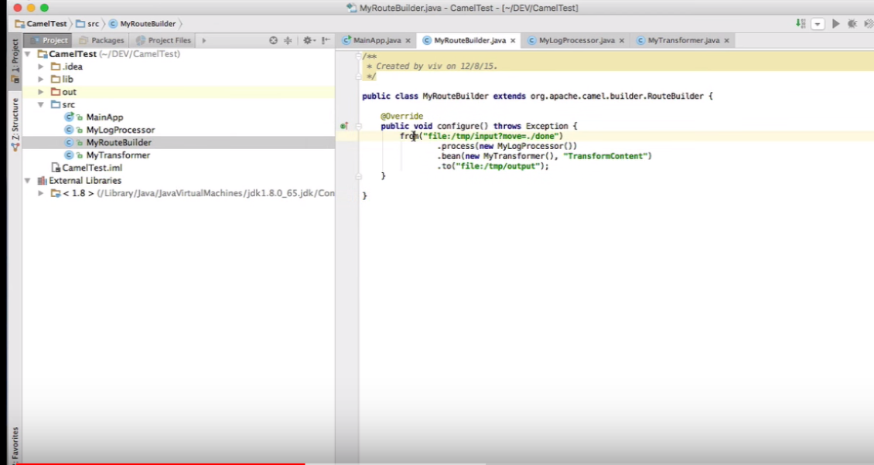

Slide 20
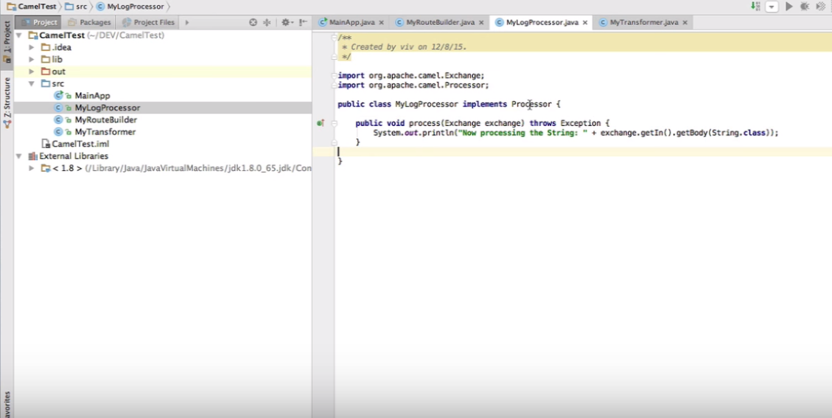

Slide 21
